Slide 1
Task Manager
Web Authering Design II
CIT-216
Mohammed Alluqman – 202210391 Faisal Alsubaie - 202110115 Faisal Salem - 202110170 Suliman Alotibe - 202210211
Ali Attyah - 202110581
Start now!

Slide 2
Table of contents
Introduction
Landing Page
Slide 3
Slide 3-4
Activity tasks
Conclusion
Slide 6-9
Slide 10

Slide 3
Introduction
Intro
Main
Description
Instructions
Conclusion
FAQ
The Task Manager project is a web-based application designed to help users efficiently organize and manage their tasks. Users can create, view, edit, and delete tasks, set priorities, and track deadlines. The project uses C#, ASP.NET, and SQL Server, providing a user-friendly interface with separate tabs for active and completed tasks. This system helps improve productivity by keeping tasks organized and on schedule.

Slide 4
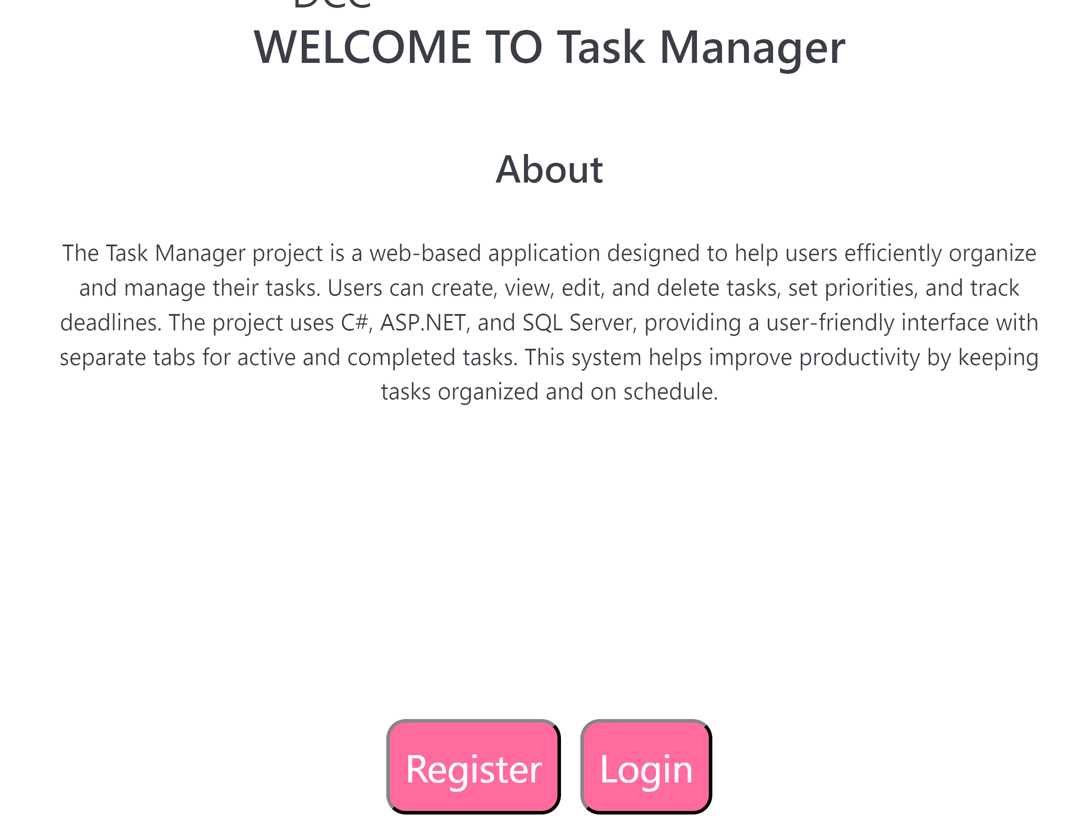
Main Page (LandingPage.aspx)
Monday
Tuesday
Wednesday
Thursday
Friday
Homework
This is the Landing Page of the Task Manager project. It welcomes users with a brief description of the app, explaining its purpose to help manage tasks efficiently. Users can click Register to create an account or Login to access the system. The design is clean with simple buttons for easy navigation.

Slide 5
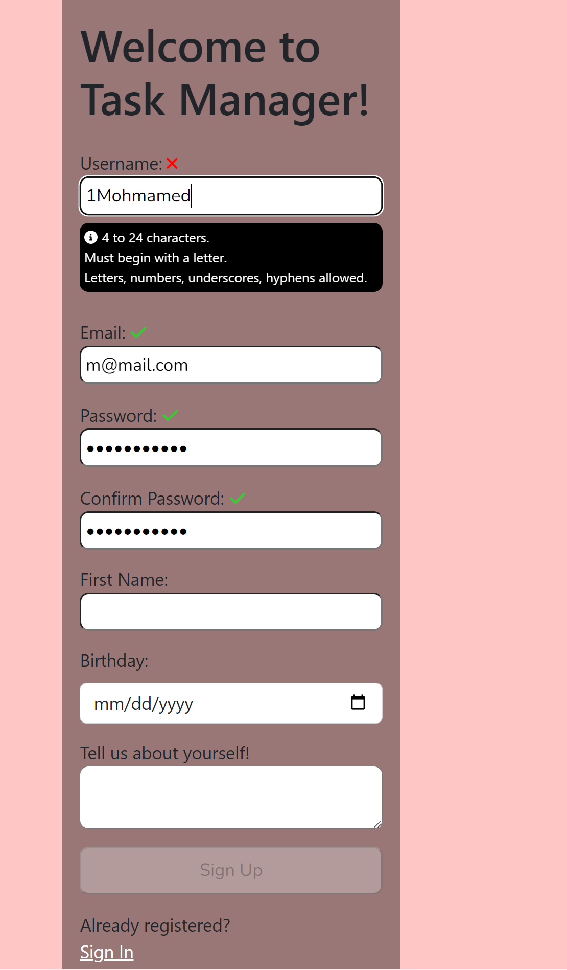
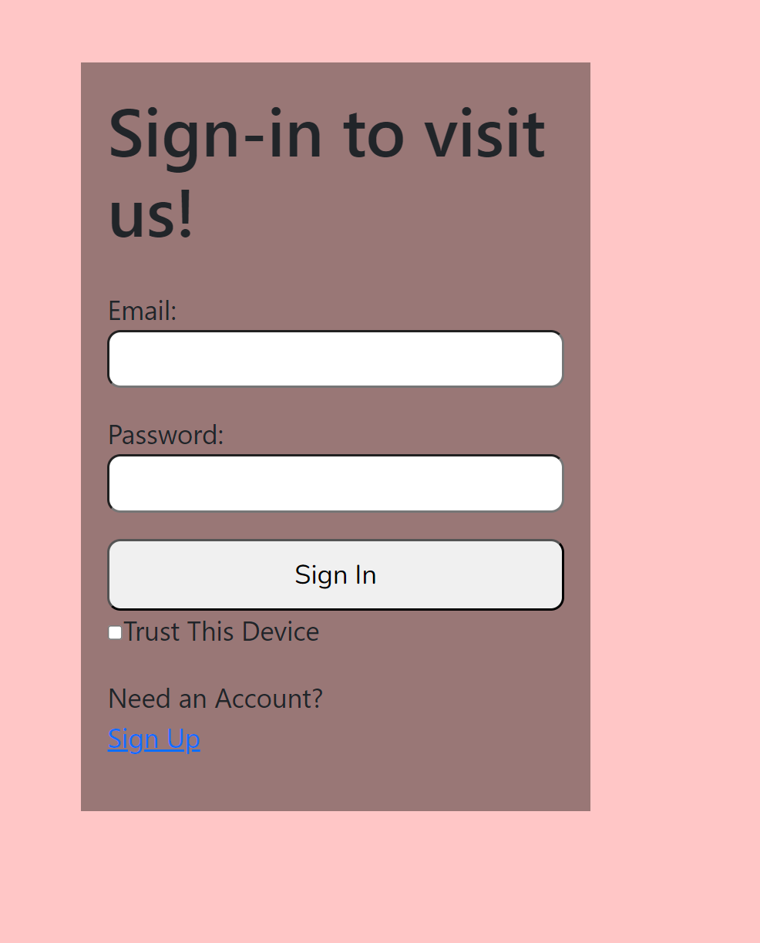
Registration and login pages
Monday
Tuesday
Wednesday
Thursday
Friday
Homework
Register
Login
The Register page, where users create an account by entering details like username, email, password, and personal information. It includes validation to ensure correct input and enables the "Sign Up" button only when all fields are valid.
The login page, allowing users to sign in with their email and password. It also includes a "Trust This Device" option and a link to register for new users.

Slide 6
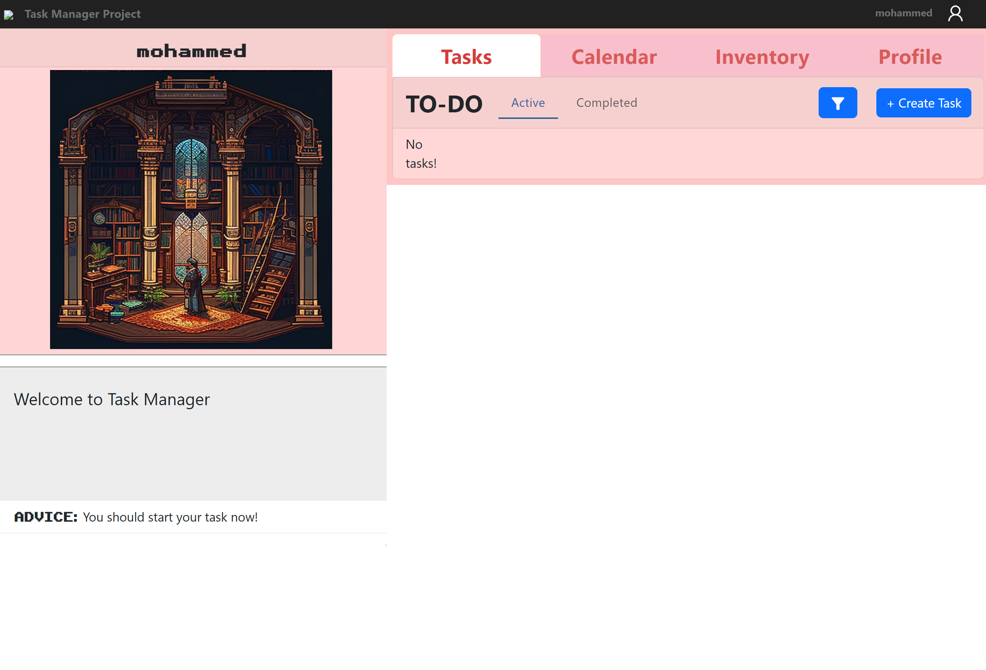
Task Dashboard (TaskManager.aspx)
Monday
Tuesday
Wednesday
Thursday
Friday
Homework
This Task Manager dashboard provides a clean layout with an "Active" tab for tasks and an intuitive "+ Create Task" button. It features personalized user elements, motivational advice, and visually appealing tabs for easy navigation.

Slide 7
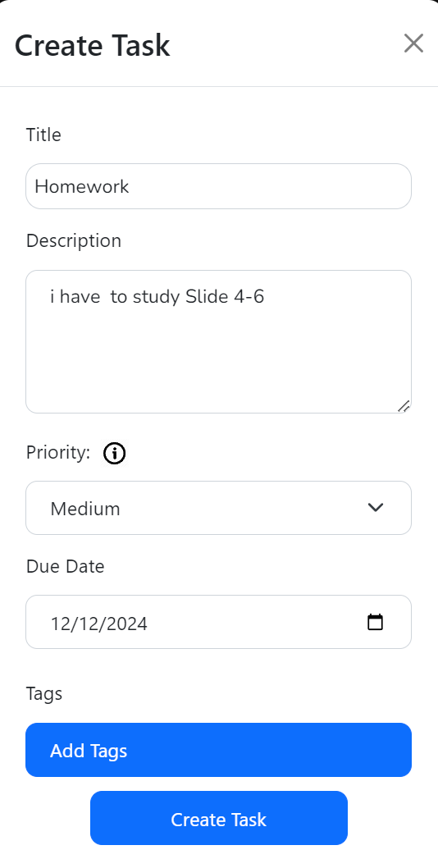
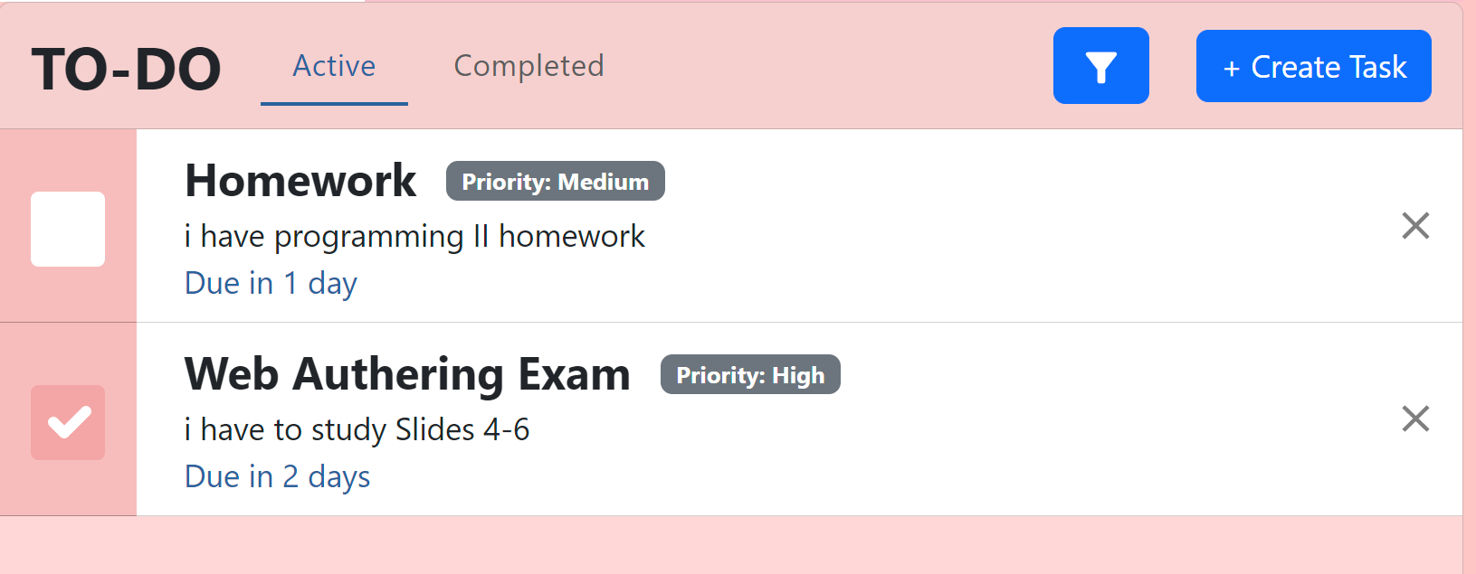
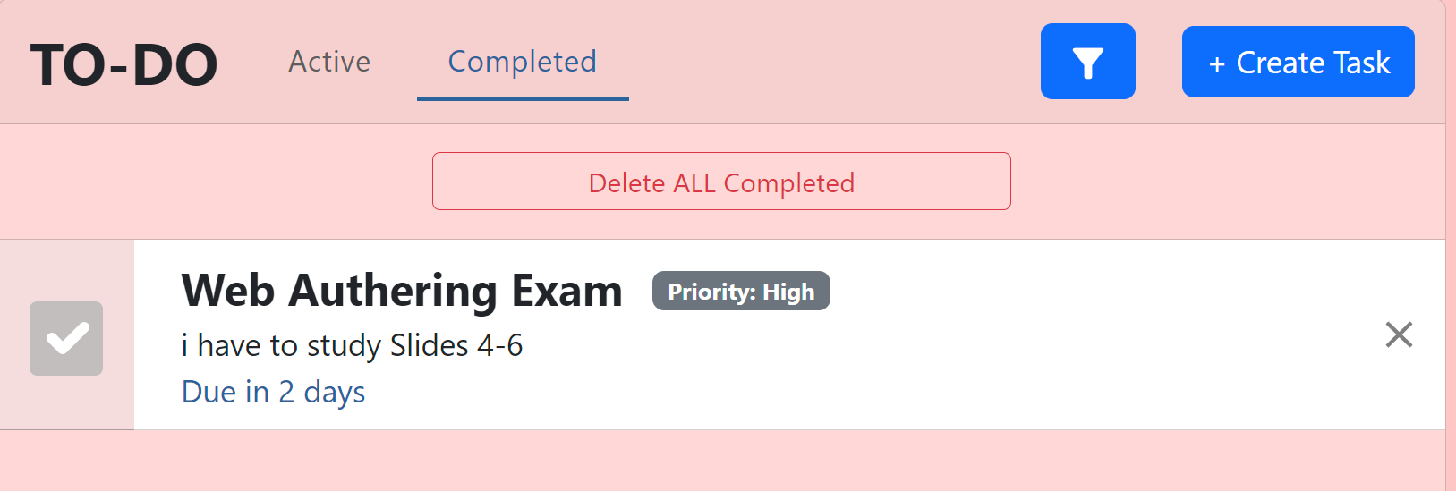
Creating a Task
Monday
Tuesday
Wednesday
Thursday
Friday
Homework
The images show the task management process. Users can create tasks with titles, descriptions, priorities, due dates, and tags. Active tasks appear in the "Active" tab, and completed tasks move to the "Completed" tab, where they can be deleted.

Slide 8
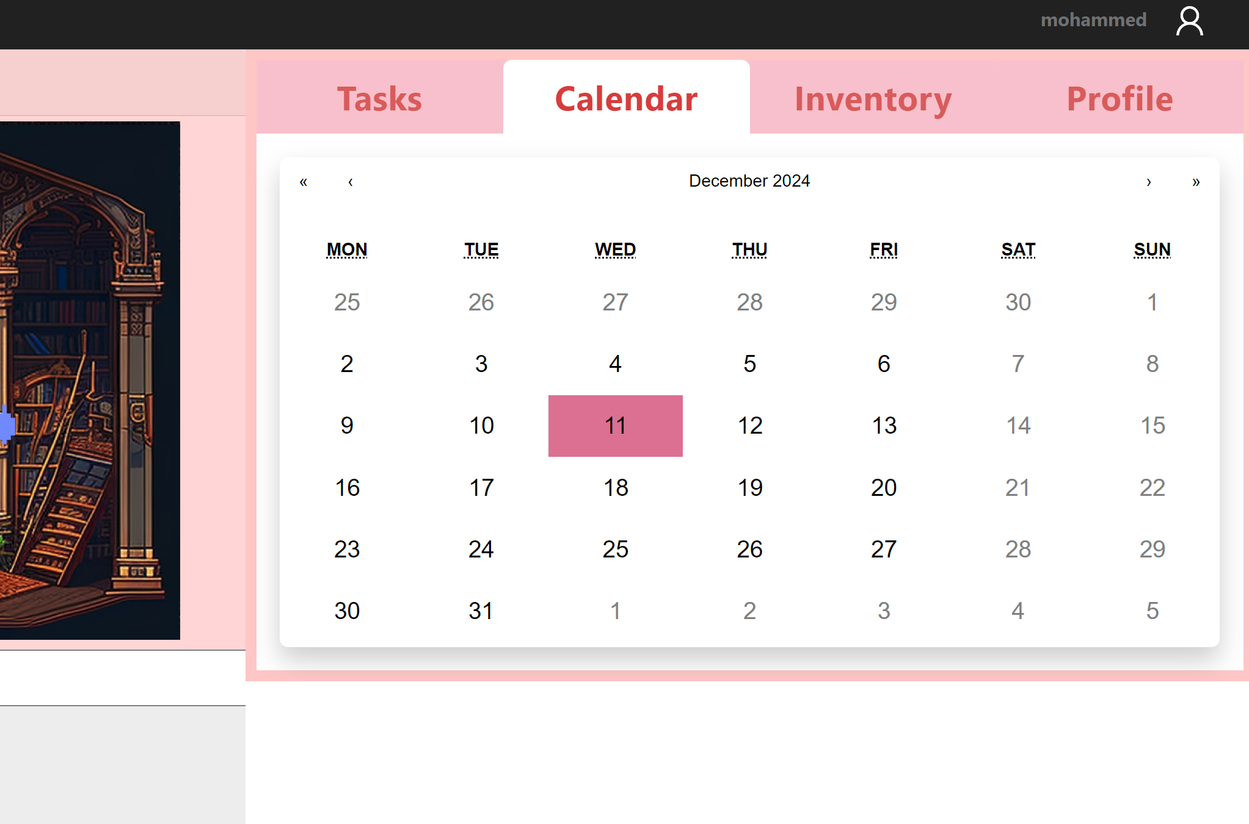
Calandar tab
Monday
Tuesday
Wednesday
Thursday
Friday
Homework
This calendar allows users to view and track dates set for their tasks and deadlines.

Slide 9
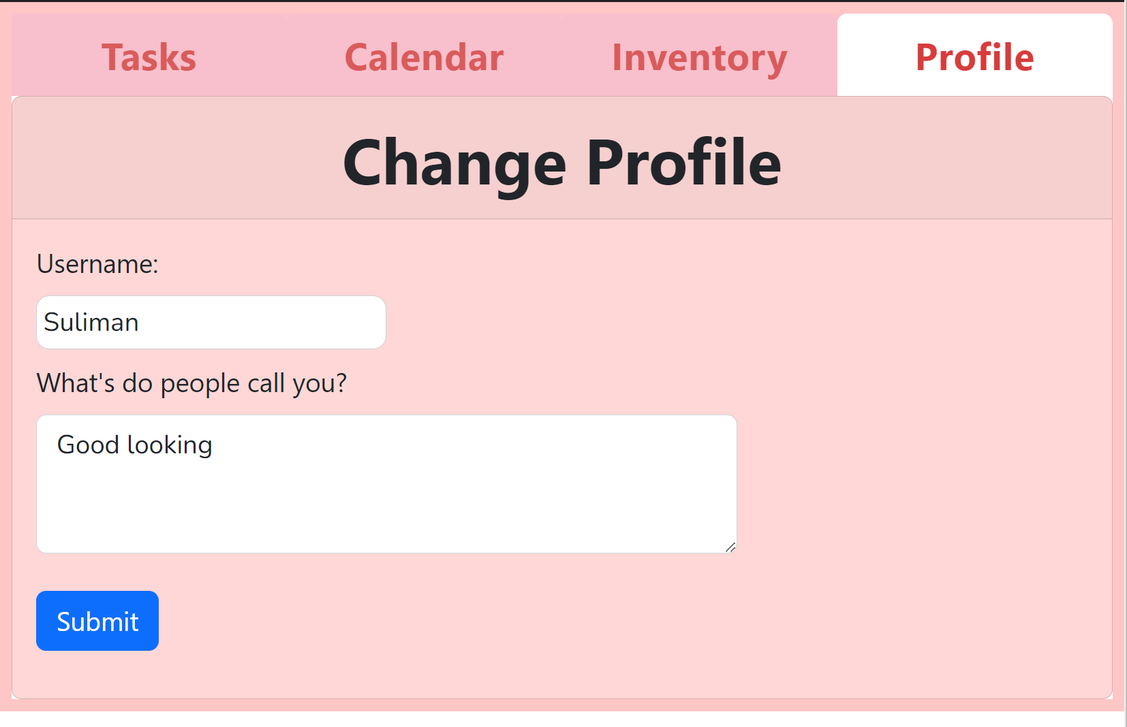
Monday
Tuesday
Wednesday
Thursday
Friday
Homework
Profile tab

Slide 10
Monday
Tuesday
Wednesday
Thursday
Friday
Homework
Conclusion
In conclusion, the Task Manager project helps users organize and manage their tasks easily. It provides features like adding, editing, and completing tasks while keeping everything organized. This system improves productivity and can be enhanced with more features in the future.

Slide 11
Any Question?
Monday
Tuesday
Wednesday
Thursday
Friday
Homework
Thanks for Listining

